Slide 1
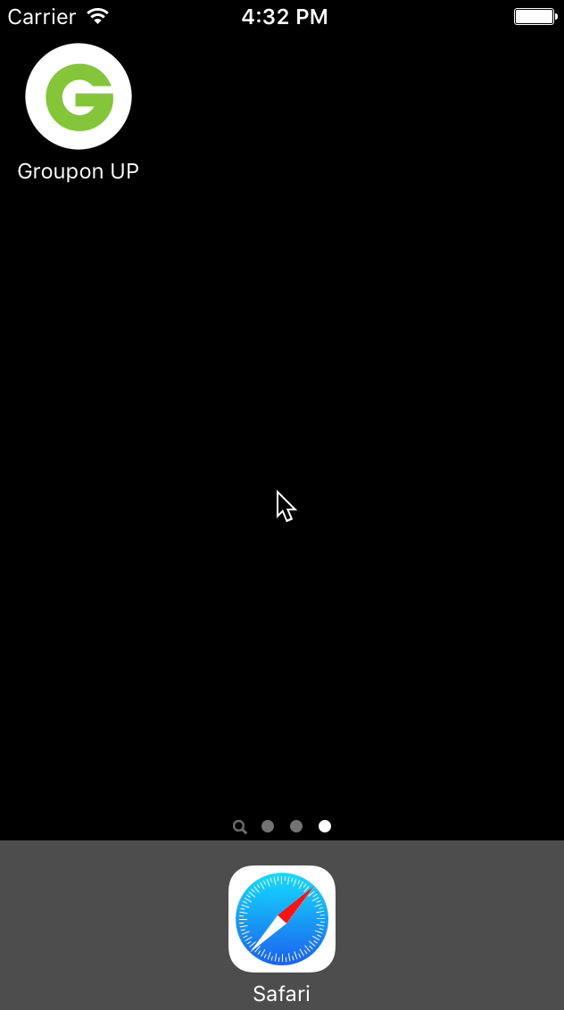
Chang Liu Robert Xue Ping Zhang
UP
iOS Bootcamp 2015
Notes:
Why do it?
The original Groupon Concept that everyone is passionate about – explore exciting new stuff together, collective buying power
We are not just a coupon shop
Our core business value, the thing differentiate us from Yelp, Expedia, Amazon – local
We have the resource that other’s don’t have to connect people with local restaurants and events, etc
But we are still a coupon shop
We want change it, we want bring everyone the real Groupon experience
Why do it now?
Back in 2008, no smart phone, no 4g network, no enough inventory, hard to connect people
Now, smart phone everywhere, fast network, tons of inventory, social network, GPS!
What’s our advantage?
It is an amazing time, we have resources, we have the power, nobody have built a similar platform that could compete with us
Yelp is probably the only real competitor, but they don’t’ have local inventory, and it takes time to build that, we have the first mover advantage (7 years ahead of them)
Future
Simply unlimited
Increase cross sale
Provide huge value to our users

